Slide 1
Employee Data Analysis using Excel
STUDENT NAME : Bhavika S
REGISTER NO : 122203805
DEPARTMENT : B.COM Corporate Secretaryship
COLLEGE : SHRI SHANKARLAL SUNDARBAI SHASUN JAIN COLLEGE FOR WOMEN

Slide 2
PROJECT TITLE
Employee Performance Analysis using Excel

Slide 3

AGENDA
Problem Statement
Project Overview
End Users
Our Solution and Proposition
Dataset Description
Modelling Approach
Results and Discussion
Conclusion
3/21/2024 Annual Review

Slide 4

PROBLEM STATEMENT
A problem statement in employee performance analysis outlines
the specific issue or challenge that needs to be addressed. It serves as
a foundation for further investigation, analysis, and potential
solutions.
Example Problem Statement:
Our company is struggling to retain top talent due to a lack of clear
performance expectations and limited opportunities for professional
development. This has resulted in decreased employee morale and a
decline in overall productivity.
By identifying the specific problems related to employee performance,
organizations can develop targeted solutions to improve their
performance management practices and achieve their goals.

Slide 5
PROJECT OVERVIEW
Excel is a versatile tool that can be used to effectively analyze employee performance data. By leveraging its functions and capabilities, organizations can gain valuable insights into their workforce, identify areas for improvement, and make data-driven decisions
Common Excel Functions Used in Employee Performance Analysis :
•AVERAGE: Calculates the average value of a range of cells.
•COUNTIF: Counts the number of cells within a range that meet a specified criterion.
•SUMIF: Adds up the values in a range that meet a specified criterion.
•VLOOKUP: Looks up a value in the first column of a table and returns the corresponding value from a specified column.
•IF: Performs a logical test and returns one value if the test is true and another value if the test is false.
•RANK: Returns the rank of a number within a list of numbers.

Slide 6

WHO ARE THE END USERS?
Human Resources (HR) Department:
Talent Management: HR professionals use performance data to identify high-potential employees, plan succession,
and develop targeted training and development programs.
Compensation and Benefits: Performance data is used to determine salary increases, bonuses, and other forms of
compensation.
Line Managers and Supervisors:
Performance Feedback: Managers use performance data to provide constructive feedback to their employees, set
goals, and monitor progress.
Coaching and Development: Managers can use performance data to identify areas where employees need additional
support and coaching.
Team Performance: Managers can analyze team performance data to identify strengths, weaknesses, and
opportunities for improvement.
Executives and Senior Leadership:
Organizational Effectiveness: Executives use performance data to assess the overall effectiveness of the
organization's talent management practices and make strategic decisions.
Succession Planning: Senior leaders can use performance data to identify potential successors and develop their
leadership skill

Slide 7
OUR SOLUTION AND ITS VALUE PROPOSITION
Filters: Manages large datasets, enabling you to focus on specific segments of data and make informed decisions based on the filtered results.
Formulas: Performs a wide range of tasks from basic arithmetic to complex data analysis to analyze data, automate tasks, and make informed decisions
.
PivotTables: Powerful tools for data analysis that allow you to summarize, analyze, explore, and present data in various ways. It allows you to easily reorganize and summarize selected columns and rows of data to obtain the desired report without altering the original data.
Graphs: Represent data in a graphical format, making it easier to understand patterns, trends, and relationships in your data. Depending on the nature of your data and the kind of analysis you can choose the graph.

Slide 8

Dataset Description
* Employee data set taken from the KAGGLE.
* In dataset , out of 26 data I took only 9 features out of it.
*The selected 10 features are listed below :
1.Employee ID
2. First name
3. Last name
4. Business unit
5.Employee type
6.Employee status
7. Employee classification type
8. Gender Code
9. Performance score
10. Current employee rating

Slide 9
THE "WOW" IN OUR SOLUTION
This are the strategies that can be used to enhance their performance and which is crucial for the success of the organization
Provide Clear Goals and Expectations
Foster a Positive Work Environment
Use Data-Driven Performance Management
Encourage Innovation and Creative Thinking
3/21/2024 Annual Review
9

Slide 10
MODELLING
DATA COLLECTION :The data has been collected through Edunet dash board.
FEATURE COLLECTION :The listed 10 features were taken for the analyses of data.
DATA CLEANING : Identifying the missing values . Filtering of those missing values.
CALCULATION OF PERFORMANCE : considering the current employee rating, I found the performance level using the formula.
SUMMARY OF PIVOT LEVEL :Segregating od certain features to rows, columns, heading and so on.
VISUALIZATION : Once completed with pivot table, created the graph for precise visualization.
10

Slide 11
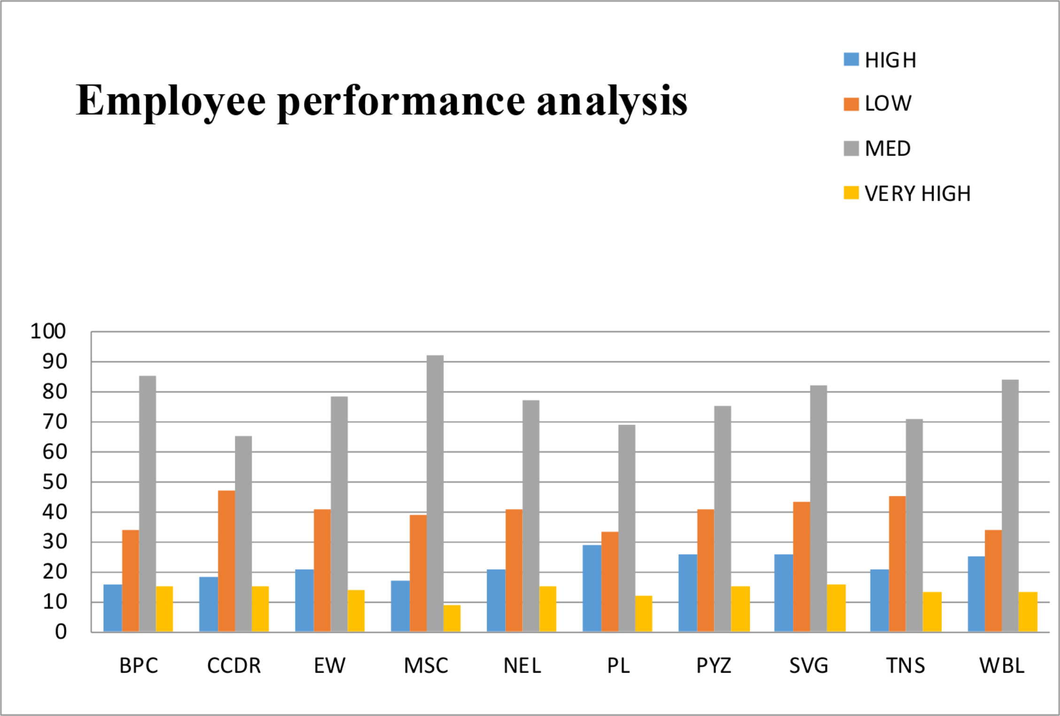
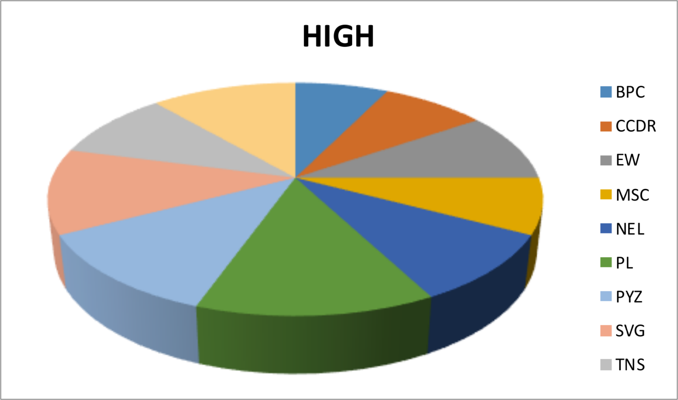
RESULTS
EMPLOYEE PERFORMANCE ANALYSIS :
11

Slide 12
conclusion
Employee performance analysis benefits a wide range of stakeholders within an
organization, from HR professionals to executives and employees themselves. By using
data-driven insights, organizations can improve employee performance, enhance talent
management practices, and achieve their strategic objectives.
We can see that the steadiness of the medium level employees prevails in each and every department. Through the analysis, I conclude that the medium level employees are high in each department
FORMULA :
Performance level = IFS(Z8>=5,’’VERY HIGH’’,Z8>=4,’’HIGH’’,Z8>=3,’’MID’’,TRUE,’’LOW’’)

